Slide 1
Chapter 16: Recovery System

Slide 2
Chapter 16: Recovery System
Failure Classification
Storage Structure
Recovery and Atomicity
Log-Based Recovery
Shadow Paging
Recovery With Concurrent Transactions
Buffer Management
Failure with Loss of Nonvolatile Storage
Advanced Recovery Techniques
ARIES Recovery Algorithm
Remote Backup Systems

Slide 3
Failure Classification
Transaction failure:
  Logical errors: transaction cannot complete due to some internal error condition
  System errors: the database system must terminate an active transaction due to an error condition (e.g., deadlock)
System crash: a power failure or other hardware or software failure causes the system to crash.
  Fail-stop assumption: non-volatile storage contents are assumed to not be corrupted by system crash
    Database systems have numerous integrity checks to prevent corruption of disk data
Disk failure: a head crash or similar disk failure destroys all or part of disk storage
  Destruction is assumed to be detectable: disk drives use checksums to detect failures

Slide 4
Recovery Algorithms
Recovery algorithms are techniques to ensure database consistency and transaction atomicity and durability despite failures.
  Focus of this chapter
Recovery algorithms have two parts:
  Actions taken during normal transaction processing to ensure enough information exists to recover from failures.
  Actions taken after a failure to recover the database contents to a state that ensures atomicity, consistency and durability.

Slide 5
Storage Structure
Volatile storage:
  does not survive system crashes
  examples: main memory, cache memory
Nonvolatile storage:
  survives system crashes
  examples: disk, tape, flash memory,
  non-volatile (battery backed up) RAM
Stable storage:
  a mythical form of storage that survives all failures
  approximated by maintaining multiple copies on distinct nonvolatile media

Slide 6
Stable-Storage Implementation
Maintain multiple copies of each block on separate disks
  copies can be at remote sites to protect against disasters such as fire or flooding.
Failure during data transfer can still result in inconsistent copies: Block transfer can result in
  Successful completion
  Partial failure: destination block has incorrect information
  Total failure: destination block was never updated
Protecting storage media from failure during data transfer (one solution):
  Execute output operation as follows (assuming two copies of each block):
    Write the information onto the first physical block.
    When the first write successfully completes, write the same information onto the second physical block.
    The output is completed only after the second write successfully completes.

Slide 7
Stable-Storage Implementation (Cont.)
Protecting storage media from failure during data transfer (cont.):
Copies of a block may differ due to failure during output operation. To recover from failure:
  First find inconsistent blocks:
    Expensive solution: Compare the two copies of every disk block.
    Better solution:
      Record in-progress disk writes on non-volatile storage (Non-volatile RAM or special area of disk).
      Use this information during recovery to find blocks that may be inconsistent, and only compare copies of these.
      Used in hardware RAID systems
  If either copy of an inconsistent block is detected to have an error (bad checksum), overwrite it by the other copy. If both have no error, but are different, overwrite the second block by the first block.

Slide 8
Data Access
Physical blocks are those blocks residing on the disk.
Buffer blocks are the blocks residing temporarily in main memory.
Block movements between disk and main memory are initiated through the following two operations:
  input(B) transfers the physical block B to main memory.
  output(B) transfers the buffer block B to the disk, and replaces the appropriate physical block there.
Each transaction T_{i} has its private work-area in which local copies of all data items accessed and updated by it are kept.
  T_{i}'s local copy of a data item X is called x_{i}.
We assume, for simplicity, that each data item fits in, and is stored inside, a single block.

Slide 9
Data Access (Cont.)
Transaction transfers data items between system buffer blocks and its private work-area using the following operations:
  read(X) assigns the value of data item X to the local variable x_{i}.
  write(X) assigns the value of local variable x_{i} to data item {X} in the buffer block.
  Both these commands may necessitate the issue of an input(B_{X}) instruction before the assignment, if the block B_{X} in which X resides is not already in memory.
Transactions
  Perform read(X) while accessing X for the first time;
  All subsequent accesses are to the local copy.
  After last access, transaction executes write(X).
output(B_{X}) need not immediately follow write(X). System can perform the output operation when it deems fit.

Slide 10
Example of Data Access
buffer
Buffer Block A
input(A)
X
A
Buffer Block B
Y
B
output(B)
read(X)
write(Y)
x₂
x₁
y₁
work area
of T₁
work area
of T₂
memory
disk

Slide 11
Recovery and Atomicity
Modifying the database without ensuring that the transaction will commit may leave the database in an inconsistent state.
Consider transaction T_{i} that transfers $50 from account A to account B; goal is either to perform all database modifications made by T_{i} or none at all.
Several output operations may be required for T_{i} (to output A and B). A failure may occur after one of these modifications have been made but before all of them are made.

Slide 12
Recovery and Atomicity (Cont.)
To ensure atomicity despite failures, we first output information describing the modifications to stable storage without modifying the database itself.
We study two approaches:
  log-based recovery, and
  shadow-paging
We assume (initially) that transactions run serially, that is, one after the other.

Slide 13
Log-Based Recovery
A log is kept on stable storage.
  The log is a sequence of log records, and maintains a record of update activities on the database.
When transaction T_{i} starts, it registers itself by writing a
<T_{i} start> log record
Before T_{i} executes write(X), a log record <T_{i}, X, V₁, V₂> is written, where V₁ is the value of X before the write, and V₂ is the value to be written to X.
  Log record notes that T_{i} has performed a write on data item X_{j} X_{j} had value V₁ before the write, and will have value V₂ after the write.
When T_{i} finishes it last statement, the log record <T_{i} commit> is written.
We assume for now that log records are written directly to stable storage (that is, they are not buffered).
Two approaches using logs
  Deferred database modification
  Immediate database modification

Slide 14
Deferred Database Modification
The deferred database modification scheme records all modifications to the log, but defers all the writes to after partial commit.
Assume that transactions execute serially
Transaction starts by writing <T_{i} start> record to log.
A write(X) operation results in a log record <T_{i}, X, V> being written, where V is the new value for X
  Note: old value is not needed for this scheme
The write is not performed on X at this time, but is deferred.
When T_{i} partially commits, <T_{i} commit> is written to the log
Finally, the log records are read and used to actually execute the previously deferred writes.

Slide 15
Deferred Database Modification (Cont.)
During recovery after a crash, a transaction needs to be redone if and only if both <T_{i} start> and <T_{i} commit> are there in the log.
Redoing a transaction T_{i} ( redoT_{i}) sets the value of all data items updated by the transaction to the new values.
Crashes can occur while
  the transaction is executing the original updates, or
  while recovery action is being taken
example transactions T₀ and T₁ (T₀ executes before T₁):
T₀ : read (A) T₁ : read (C)
A: - A - 50 C: - C- 100
Write (A) write (C)
read (B)
B:- B + 50
write (B)

Slide 16

Deferred Database Modification (Cont.)
Below we show the log as it appears at three instances of time.
If log on stable storage at time of crash is as in case:
(a) No redo actions need to be taken
(b) redo(T₀) must be performed since <T₀ commit> is present
(c) redo(T₀) must be performed followed by redo(T₁) since
<T₀ commit> and <T_{i} commit> are present

Slide 17
Immediate Database Modification
The immediate database modification scheme allows database updates of an uncommitted transaction to be made as the writes are issued.
  since undoing may be needed, update logs must have both old value and new value.
Update log record must be written before database item is written.
  We assume that the log record is output directly to stable storage.
  Can be extended to postpone log record output, so long as prior to execution of an output(B) operation for a data block B, all log records corresponding to items B must be flushed to stable storage.
Output of updated blocks can take place at any time before or after transaction commit.
Order in which blocks are output can be different from the order in which they are written.

Slide 18
Immediate Database Modification Example
Log Write Output
<T₀ start>
<T₀, A, 1000, 950>
T_{o}, B, 2000, 2050
A = 950
B = 2050
<T₀ commit>
<T₁ start>
<T₁, C, 700, 600>
C = 600
B_{B}, B_{C}
<T₁ commit>
B_{A}
Note: B_{X} denotes block containing X.
x₁

Slide 19
Immediate Database Modification (Cont.)
Recovery procedure has two operations instead of one:
  undo(T_{i}) restores the value of all data items updated by T_{i} to their old values, going backwards from the last log record for T_{i}.
  redo(T_{i}) sets the value of all data items updated by T_{i} to the new values, going forward from the first log record for T_{i}.
Both operations must be idempotent
  That is, even if the operation is executed multiple times the effect is the same as if it is executed once
    Needed since operations may get re-executed during recovery
When recovering after failure:
  Transaction T_{i} needs to be undone if the log contains the record
  <T_{i} start>, but does not contain the record <T_{i} commit>.
  Transaction T_{i} needs to be redone if the log contains both the record <T_{i} start> and the record <T_{i} commit>.
Undo operations are performed first, then redo operations.

Slide 20

Immediate DB Modification Recovery Example
Below we show the log as it appears at three instances of time.
Recovery actions in each case above are:
(a) undo (T₀): B is restored to 2000 and A to 1000.
(b) undo (T₁) and redo (T₀): C is restored to 700, and then A and B are
set to 950 and 2050 respectively.
(c) redo (T₀) and redo (T₁): A and B are set to 950 and 2050
respectively. Then C is set to 600

Slide 21
Checkpoints
Problems in recovery procedure as discussed earlier:
  searching the entire log is time-consuming
  we might unnecessarily redo transactions which have already
  output their updates to the database.
Streamline recovery procedure by periodically performing checkpointing
  Output all log records currently residing in main memory onto stable storage.
  Output all modified buffer blocks to the disk.
  Write a log record < checkpoint> onto stable storage.

Slide 22
Checkpoints (Cont.)
During recovery we need to consider only the most recent transaction T_{i} that started before the checkpoint, and transactions that started after T_{i}.
  Scan backwards from end of log to find the most recent <checkpoint> record
  Continue scanning backwards till a record <T_{i} start> is found.
  Need only consider the part of log following above start record. Earlier part of log can be ignored during recovery, and can be erased whenever desired.
  For all transactions (starting from T_{i} or later) with no <T_{i} commit>, execute undo(T_{i}). (Done only in case of immediate modification.)
  Scanning forward in the log, for all transactions starting from T_{i} or later with a <T_{i} commit>, execute redo(T_{i}).

Slide 23
Example of Checkpoints
T_{c}
T_{f}
T₁ can be ignored (updates already output to disk due to checkpoint)
T₂ and T₃ redone.
T₄ undone
T₁
T₂
T₃
T₄
checkpoint
system failure

Slide 24
Recovery With Concurrent Transactions
We modify the log-based recovery schemes to allow multiple transactions to execute concurrently.
  All transactions share a single disk buffer and a single log
  A buffer block can have data items updated by one or more transactions
We assume concurrency control using strict two-phase locking;
  i.e., the updates of uncommitted transactions should not be visible to other transactions
    Otherwise how to perform undo if T1 updates A, then T2 updates A and commits, and finally T1 has to abort?
Logging is done as described earlier.
  Log records of different transactions may be interspersed in the log.
The checkpointing technique and actions taken on recovery have to be changed
  since several transactions may be active when a checkpoint is performed.

Slide 25
Recovery With Concurrent Transactions (Cont.)
Checkpoints are performed as before, except that the checkpoint log record is now of the form
< checkpoint L>
where L is the list of transactions active at the time of the checkpoint
  We assume no updates are in progress while the checkpoint is carried out (will relax this later)
When the system recovers from a crash, it first does the following:
  Initialize undo-list and redo-list to empty
  Scan the log backwards from the end, stopping when the first <checkpoint L> record is found.
  For each record found during the backward scan:
    if the record is <T_{i} commit>, add T_{i} to redo-list
    if the record is <T_{i} start>, then if T_{i} is not in redo-list, add T_{i} to undo-list
  For every T_{i} in L, if T_{i} is not in redo-list, add T_{i} to undo-list

Slide 26
Recovery With Concurrent Transactions (Cont.)
At this point undo-list consists of incomplete transactions which must be undone, and redo-list consists of finished transactions that must be redone.
Recovery now continues as follows:
  Scan log backwards from most recent record, stopping when
  <T_{i} start> records have been encountered for every T_{i} in undo-list.
    During the scan, perform undo for each log record that belongs to a transaction in undo-list.
  Locate the most recent <checkpoint L> record.
  Scan log forwards from the <checkpoint L> record till the end of the log.
    During the scan, perform redo for each log record that belongs to a transaction on redo-list

Slide 27
Example of Recovery
Go over the steps of the recovery algorithm on the following log:
        <T₀ start>
        <T₀, A, 0, 10>
        <T₀ commit>
        <T₁ start> /* Scan at step 1 comes up to here */
        <T₁, B, 0, 10>
        <T₂ start>
        <T₂, C, 0, 10>
        <T₂, C, 10, 20>
        <checkpoint {T₁, T₂}>
        <T₃ start>
        <T₃, A, 10, 20>
        <T₃, D, 0, 10>
        <T₃ commit>

Slide 28
Log Record Buffering
Log record buffering: log records are buffered in main memory, instead of of being output directly to stable storage.
  Log records are output to stable storage when a block of log records in the buffer is full, or a log force operation is executed.
Log force is performed to commit a transaction by forcing all its log records (including the commit record) to stable storage.
Several log records can thus be output using a single output operation, reducing the I/O cost.

Slide 29
Log Record Buffering (Cont.)
The rules below must be followed if log records are buffered:
  Log records are output to stable storage in the order in which they are created.
  Transaction T_{i} enters the commit state only when the log record
  <T_{i} commit> has been output to stable storage.
  Before a block of data in main memory is output to the database, all log records pertaining to data in that block must have been output to stable storage.
    This rule is called the write-ahead logging or WAL rule
      Strictly speaking WAL only requires undo information to be output.

Slide 30
Database Buffering
Database maintains an in-memory buffer of data blocks
  When a new block is needed, if buffer is full an existing block needs to be removed from buffer
  If the block chosen for removal has been updated, it must be output to disk
If a block with uncommitted updates is output to disk, log records with undo information for the updates are output to the log on stable storage first
  (Write ahead logging)
No updates should be in progress on a block when it is output to disk. Can be ensured as follows.
  Before writing a data item, transaction acquires exclusive lock on block containing the data item
  Lock can be released once the write is completed.
    Such locks held for short duration are called latches.
  Before a block is output to disk, the system acquires an exclusive latch on the block
    Ensures no update can be in progress on the block

Slide 31
Buffer Management (Cont.)
Database buffer can be implemented either
  in an area of real main-memory reserved for the database, or
  in virtual memory
Implementing buffer in reserved main-memory has drawbacks:
  Memory is partitioned before-hand between database buffer and applications, limiting flexibility.
  Needs may change, and although operating system knows best how memory should be divided up at any time, it cannot change the partitioning of memory.

Slide 32
Buffer Management (Cont.)
Database buffers are generally implemented in virtual memory in spite of some drawbacks:
  When operating system needs to evict a page that has been modified, the page is written to swap space on disk.
  When database decides to write buffer page to disk, buffer page may be in swap space, and may have to be read from swap space on disk and output to the database on disk, resulting in extra I/O!
    Known as dual paging problem.
  Ideally when OS needs to evict a page from the buffer, it should pass control to database, which in turn should
    Output the page to database instead of to swap space (making sure to output log records first), if it is modified
    Release the page from the buffer, for the OS to use
Dual paging can thus be avoided, but common operating systems do not support such functionality.

Slide 33
Failure with Loss of Nonvolatile Storage
So far we assumed no loss of non-volatile storage
Technique similar to checkpointing used to deal with loss of non-volatile storage
  Periodically dump the entire content of the database to stable storage
  No transaction may be active during the dump procedure; a procedure similar to checkpointing must take place
    Output all log records currently residing in main memory onto stable storage.
    Output all buffer blocks onto the disk.
    Copy the contents of the database to stable storage.
    Output a record <dump> to log on stable storage.

Slide 34
Recovering from Failure of Non-Volatile Storage
To recover from disk failure
  restore database from most recent dump.
  Consult the log and redo all transactions that committed after the dump
Can be extended to allow transactions to be active during dump;
known as fuzzy dump or online dump
  Will study fuzzy checkpointing later

Slide 35
Advanced Recovery Algorithm

Slide 36
Advanced Recovery: Key Features
Support for high-concurrency locking techniques, such as those used for B⁺-tree concurrency control, which release locks early
  Supports “logical undo”
Recovery based on “repeating history”, whereby recovery executes exactly the same actions as normal processing
  including redo of log records of incomplete transactions, followed by subsequent undo
  Key benefits
    supports logical undo
    easier to understand/show correctness

Slide 37
Advanced Recovery: Logical Undo Logging
Operations like B⁺-tree insertions and deletions release locks early.
  They cannot be undone by restoring old values (physical undo), since once a lock is released, other transactions may have updated the B⁺-tree.
  Instead, insertions (resp. deletions) are undone by executing a deletion (resp. insertion) operation (known as logical undo).
For such operations, undo log records should contain the undo operation to be executed
  Such logging is called logical undo logging, in contrast to physical undo logging
    Operations are called logical operations
  Other examples:
    delete of tuple, to undo insert of tuple
      allows early lock release on space allocation information
    subtract amount deposited, to undo deposit
      allows early lock release on bank balance

Slide 38
Advanced Recovery: Physical Redo
Redo information is logged physically (that is, new value for each write) even for operations with logical undo
  Logical redo is very complicated since database state on disk may not be “operation consistent” when recovery starts
  Physical redo logging does not conflict with early lock release

Slide 39
Advanced Recovery: Operation Logging
Operation logging is done as follows:
  When operation starts, log <T_{i} , O_{j} , operation-begin>. Here O_{j} is a unique identifier of the operation instance.
  While operation is executing, normal log records with physical redo and physical undo information are logged.
  When operation completes, <T_{i}, O_{j} , operation-end, U> is logged, where U contains information needed to perform a logical undo information.
Example: insert of (key, record-id) pair (K5, RID7) into index I9
<T1, O1, operation-begin>
….
<T1, X, 10, K5>
<T1, Y, 45, RID7>
<T1, O1, operation-end, (delete I9, K5, RID7)>
Physical redo of steps in insert

Slide 40
Advanced Recovery: Operation Logging (Cont.)
If crash/rollback occurs before operation completes:
  the operation-end log record is not found, and
  the physical undo information is used to undo operation.
If crash/rollback occurs after the operation completes:
  the operation-end log record is found, and in this case
  logical undo is performed using U; the physical undo information for the operation is ignored.
Redo of operation (after crash) still uses physical redo information.

Slide 41
Advanced Recovery: Txn Rollback
Rollback of transaction T_{i} is done as follows:
Scan the log backwards
  If a log record <T_{i} , X , V₁ , V₂> is found, perform the undo and log a special redo-only log record <T_{i} , X , V₁ >.
  If a <T_{i} , O_{j} , operation-end, U> record is found
    Rollback the operation logically using the undo information U.
      Updates performed during roll back are logged just like during normal operation execution.
      At the end of the operation rollback, instead of logging an operation-end record, generate a record
    <T_{i} , O_{j} , operation-abort>.
    Skip all preceding log records for T_{i} until the record
    <T_{i} , O_{j} operation-begin> is found

Slide 42
Advanced Recovery: Txn Rollback (Cont.)
Scan the log backwards (cont.):
  If a redo-only record is found ignore it
  If a <T_{i} , O_{j} , operation-abort> record is found:
    skip all preceding log records for T_{i} until the record
    <T_{i} , O_{j} , operation-begin> is found.
  Stop the scan when the record <T_{i} , start> is found
  Add a <T_{i} , abort> record to the log
Some points to note:
Cases 3 and 4 above can occur only if the database crashes while a transaction is being rolled back.
Skipping of log records as in case 4 is important to prevent multiple rollback of the same operation.

Slide 43
Advanced Recovery: Txn Rollback Example
Example with a complete and an incomplete operation
<T1, start>
<T1, O1, operation-begin>
….
<T1, X, 10, K5>
<T1, Y, 45, RID7>
<T1, O1, operation-end, (delete I9, K5, RID7)>
<T1, O2, operation-begin>
<T1, Z, 45, 70>
← T1 Rollback begins here
<T1, Z, 45> ← redo-only log record during physical undo (of incomplete O2)
<T1, Y, .., ..> ← Normal redo records for logical undo of O1
…
<T1, O1, operation-abort> ← What if crash occurred immediately after this?
<T1, abort>

Slide 44
Advanced Recovery: Crash Recovery
The following actions are taken when recovering from system crash
(Redo phase): Scan log forward from last < checkpoint L> record till end of log
  Repeat history by physically redoing all updates of all transactions,
  Create an undo-list during the scan as follows
    undo-list is set to L initially
    Whenever <T_{i} start> is found T_{i} is added to undo-list
    Whenever <T_{i} commit> or <T_{i} abort> is found, T_{i} is deleted from undo-list
This brings database to state as of crash, with committed as well as uncommitted transactions having been redone.
Now undo-list contains transactions that are incomplete, that is, have neither committed nor been fully rolled back.

Slide 45
Advanced Recovery: Crash Recovery (Cont.)
Recovery from system crash (cont.)
(Undo phase): Scan log backwards, performing undo on log records of transactions found in undo-list.
  Log records of transactions being rolled back are processed as described earlier, as they are found
    Single shared scan for all transactions being undone
  When <T_{i} start> is found for a transaction T_{i} in undo-list, write a <T_{i} abort> log record.
  Stop scan when <T_{i} start> records have been found for all T_{i} in undo-list
This undoes the effects of incomplete transactions (those with neither commit nor abort log records). Recovery is now complete.

Slide 46
Advanced Recovery: Checkpointing
Checkpointing is done as follows:
  Output all log records in memory to stable storage
  Output to disk all modified buffer blocks
  Output to log on stable storage a <checkpoint L> record.
Transactions are not allowed to perform any actions while checkpointing is in progress.
Fuzzy checkpointing allows transactions to progress while the most time consuming parts of checkpointing are in progress
  Performed as described on next slide

Slide 47
Advanced Recovery: Fuzzy Checkpointing
Fuzzy checkpointing is done as follows:
  Temporarily stop all updates by transactions
  Write a <checkpoint L> log record and force log to stable storage
  Note list M of modified buffer blocks
  Now permit transactions to proceed with their actions
  Output to disk all modified buffer blocks in list M
    blocks should not be updated while being output
    Follow WAL: all log records pertaining to a block must be output before the block is output
  Store a pointer to the checkpoint record in a fixed position last_checkpoint on disk
……
<checkpoint L>
…..
<checkpoint L>
…..
last_checkpoint
Log

Slide 48
Advanced Rec: Fuzzy Checkpointing (Cont.)
When recovering using a fuzzy checkpoint, start scan from the checkpoint record pointed to by last_checkpoint
  Log records before last_checkpoint have their updates reflected in database on disk, and need not be redone.
  Incomplete checkpoints, where system had crashed while performing checkpoint, are handled safely

Slide 49
ARIES Recovery Algorithm

Slide 50
ARIES
ARIES is a state of the art recovery method
  Incorporates numerous optimizations to reduce overheads during normal processing and to speed up recovery
  The “advanced recovery algorithm” we studied earlier is modeled after ARIES, but greatly simplified by removing optimizations
Unlike the advanced recovery algorithm, ARIES
  Uses log sequence number (LSN) to identify log records
    Stores LSNs in pages to identify what updates have already been applied to a database page
  Physiological redo
  Dirty page table to avoid unnecessary redos during recovery
  Fuzzy checkpointing that only records information about dirty pages, and does not require dirty pages to be written out at checkpoint time
    More coming up on each of the above …

Slide 51
ARIES Optimizations
Physiological redo
  Affected page is physically identified, action within page can be logical
    Used to reduce logging overheads
      e.g. when a record is deleted and all other records have to be moved to fill hole
        Physiological redo can log just the record deletion
        Physical redo would require logging of old and new values for much of the page
    Requires page to be output to disk atomically
      Easy to achieve with hardware RAID, also supported by some disk systems
      Incomplete page output can be detected by checksum techniques,
        But extra actions are required for recovery
        Treated as a media failure

Slide 52
ARIES Data Structures
ARIES uses several data structures
  Log sequence number (LSN) identifies each log record
    Must be sequentially increasing
    Typically an offset from beginning of log file to allow fast access
      Easily extended to handle multiple log files
  Page LSN
  Log records of several different types
  Dirty page table

Slide 53
ARIES Data Structures: Page LSN
Each page contains a PageLSN which is the LSN of the last log record whose effects are reflected on the page
  To update a page:
    X-latch the page, and write the log record
    Update the page
    Record the LSN of the log record in PageLSN
    Unlock page
  To flush page to disk, must first S-latch page
    Thus page state on disk is operation consistent
      Required to support physiological redo
  PageLSN is used during recovery to prevent repeated redo
    Thus ensuring idempotence

Slide 54
ARIES Data Structures: Log Record
Each log record contains LSN of previous log record of the same transaction
  LSN in log record may be implicit
Special redo-only log record called compensation log record (CLR) used to log actions taken during recovery that never need to be undone
  Serves the role of operation-abort log records used in advanced recovery algorithm
  Has a field UndoNextLSN to note next (earlier) record to be undone
    Records in between would have already been undone
    Required to avoid repeated undo of already undone actions
LSN TransID PrevLSN RedoInfo UndoInfo
LSN TransID UndoNextLSN RedoInfo
1
2
3
4
4'
3'
2'
1'

Slide 55
ARIES Data Structures: DirtyPage Table
DirtyPageTable
  List of pages in the buffer that have been updated
  Contains, for each such page
    PageLSN of the page
    RecLSN is an LSN such that log records before this LSN have already been applied to the page version on disk
      Set to current end of log when a page is inserted into dirty page table (just before being updated)
      Recorded in checkpoints, helps to minimize redo work
Page LSNs
on disk
P1
P6
P23
Page PLSN RLSN
P1 25 17
P6 16 15
P23 19 18
P1 16
…
P6 12
..
P15 9
..
P23 11
25
16
19
P15
9
Buffer Pool
DirtyPage Table

Slide 56
ARIES Data Structures: Checkpoint Log
Checkpoint log record
  Contains:
    DirtyPageTable and list of active transactions
    For each active transaction, LastLSN, the LSN of the last log record written by the transaction
  Fixed position on disk notes LSN of last completed
  checkpoint log record
Dirty pages are not written out at checkpoint time
    Instead, they are flushed out continuously, in the background
Checkpoint is thus very low overhead
  can be done frequently

Slide 57
ARIES Recovery Algorithm
ARIES recovery involves three passes:
Analysis pass: Determines
  Which transactions to undo
  Which pages were dirty (disk version not up to date) at time of crash
  RedoLSN: LSN from which redo should start
Redo pass:
  Repeats history, redoing all actions from RedoLSN
    RecLSN and PageLSNs are used to avoid redoing actions already reflected on page
Undo pass:
  Rolls back all incomplete transactions
    Transactions whose abort was complete earlier are not undone
      Key idea: no need to undo these transactions: earlier undo actions were logged, and are redone as required

Slide 58
Aries Recovery: 3 Passes
Analysis, redo and undo passes
Analysis determines where redo should start
Undo has to go back till start of earliest incomplete transaction
Last checkpoint
End of Log
Time
Log
Analysis pass
Redo pass
Undo pass

Slide 59
ARIES Recovery: Analysis
Analysis pass
Starts from last complete checkpoint log record
  Reads DirtyPageTable from log record
  Sets RedoLSN = min of RecLSNs of all pages in DirtyPageTable
    In case no pages are dirty, RedoLSN = checkpoint record’s LSN
  Sets undo-list = list of transactions in checkpoint log record
  Reads LSN of last log record for each transaction in undo-list from checkpoint log record
Scans forward from checkpoint
.. Cont. on next page …

Slide 60
ARIES Recovery: Analysis (Cont.)
Analysis pass (cont.)
Scans forward from checkpoint
  If any log record found for transaction not in undo-list, adds transaction to undo-list
  Whenever an update log record is found
    If page is not in DirtyPageTable, it is added with RecLSN set to LSN of the update log record
  If transaction end log record found, delete transaction from undo-list
  Keeps track of last log record for each transaction in undo-list
    May be needed for later undo
At end of analysis pass:
  RedoLSN determines where to start redo pass
  RecLSN for each page in DirtyPageTable used to minimize redo work
  All transactions in undo-list need to be rolled back

Slide 61
ARIES Redo Pass
Redo Pass: Repeats history by replaying every action not already reflected in the page on disk, as follows:
Scans forward from RedoLSN. Whenever an update log record is found:
  If the page is not in DirtyPageTable or the LSN of the log record is less than the RecLSN of the page in DirtyPageTable, then skip the log record
  Otherwise fetch the page from disk. If the PageLSN of the page fetched from disk is less than the LSN of the log record, redo the log record
NOTE: if either test is negative the effects of the log record have already appeared on the page. First test avoids even fetching the page from disk!

Slide 62
ARIES Undo Actions
When an undo is performed for an update log record
  Generate a CLR containing the undo action performed (actions performed during undo are logged physicaly or physiologically).
    CLR for record n noted as n’ in figure below
  Set UndoNextLSN of the CLR to the PrevLSN value of the update log record
    Arrows indicate UndoNextLSN value
ARIES supports partial rollback
  Used e.g. to handle deadlocks by rolling back just enough to release reqd. locks
  Figure indicates forward actions after partial rollbacks
    records 3 and 4 initially, later 5 and 6, then full rollback
1
2
3
4
4'
3'
5
6
6'
5'
1'
2'

Slide 63
ARIES: Undo Pass
Undo pass:
Performs backward scan on log undoing all transaction in undo-list
  Backward scan optimized by skipping unneeded log records as follows:
    Next LSN to be undone for each transaction set to LSN of last log record for transaction found by analysis pass.
    At each step pick largest of these LSNs to undo, skip back to it and undo it
    After undoing a log record
      For ordinary log records, set next LSN to be undone for transaction to PrevLSN noted in the log record
      For compensation log records (CLRs) set next LSN to be undo to UndoNextLSN noted in the log record
        All intervening records are skipped since they would have been undone already
Undos performed as described earlier

Slide 64
Other ARIES Features
Recovery Independence
  Pages can be recovered independently of others
    E.g., if some disk pages fail they can be recovered from a backup while other pages are being used
Savepoints:
  Transactions can record savepoints and roll back to a savepoint
    Useful for complex transactions
    Also used to rollback just enough to release locks on deadlock

Slide 65
Other ARIES Features (Cont.)
Fine-grained locking:
  Index concurrency algorithms that permit tuple level locking on indices can be used
    These require logical undo, rather than physical undo, as in advanced recovery algorithm
Recovery optimizations: For example:
  Dirty page table can be used to prefetch pages during redo
  Out of order redo is possible:
    redo can be postponed on a page being fetched from disk, and performed when page is fetched.
    Meanwhile other log records can continue to be processed

Slide 66
Remote Backup Systems

Slide 67
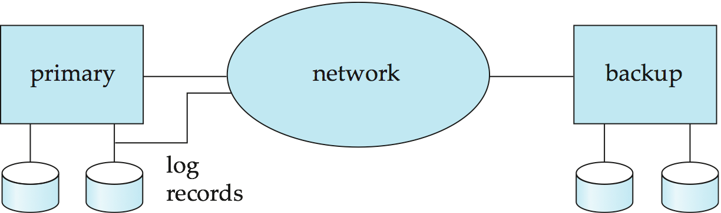
Remote Backup Systems
Remote backup systems provide high availability by allowing transaction processing to continue even if the primary site is destroyed.

Slide 68
Remote Backup Systems (Cont.)
Detection of failure: Backup site must detect when primary site has failed
  to distinguish primary site failure from link failure maintain several communication links between the primary and the remote backup.
  Heart-beat messages
Transfer of control:
  To take over control backup site first perform recovery using its copy of the database and all the long records it has received from the primary.
    Thus, completed transactions are redone and incomplete transactions are rolled back.
  When the backup site takes over processing it becomes the new primary
  To transfer control back to old primary when it recovers, old primary must receive redo logs from the old backup and apply all updates locally.

Slide 69
Remote Backup Systems (Cont.)
Time to recover: To reduce delay in takeover, backup site periodically proceses the redo log records (in effect, performing recovery from previous database state), performs a checkpoint, and can then delete earlier parts of the log.
Hot-Spare configuration permits very fast takeover:
  Backup continually processes redo log record as they arrive, applying the updates locally.
  When failure of the primary is detected the backup rolls back incomplete transactions, and is ready to process new transactions.
Alternative to remote backup: distributed database with replicated data
  Remote backup is faster and cheaper, but less tolerant to failure
    more on this in Chapter 19

Slide 70
Remote Backup Systems (Cont.)
Ensure durability of updates by delaying transaction commit until update is logged at backup; avoid this delay by permitting lower degrees of durability.
One-safe: commit as soon as transaction’s commit log record is written at primary
  Problem: updates may not arrive at backup before it takes over.
Two-very-safe: commit when transaction’s commit log record is written at primary and backup
  Reduces availability since transactions cannot commit if either site fails.
Two-safe: proceed as in two-very-safe if both primary and backup are active. If only the primary is active, the transaction commits as soon as is commit log record is written at the primary.
  Better availability than two-very-safe; avoids problem of lost transactions in one-safe.

Slide 71
End of Chapter 16

Slide 72
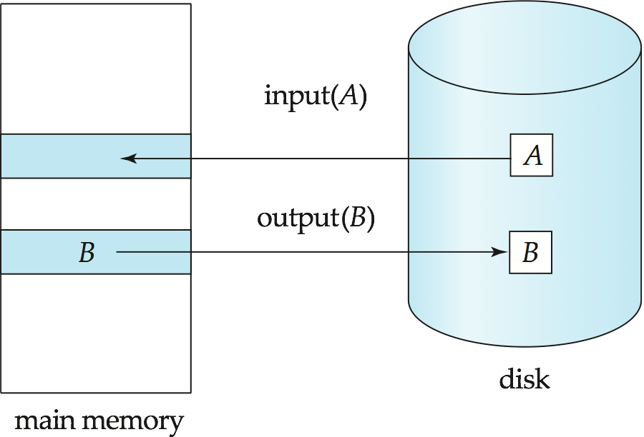
Figure 16.01

Slide 73
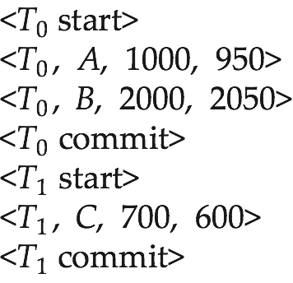
Figure 16.02

Slide 74
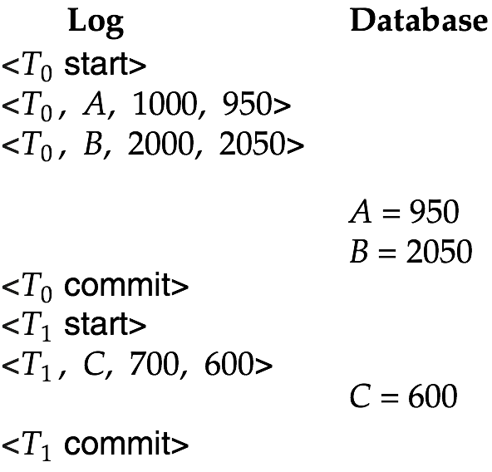
Figure 16.03

Slide 75
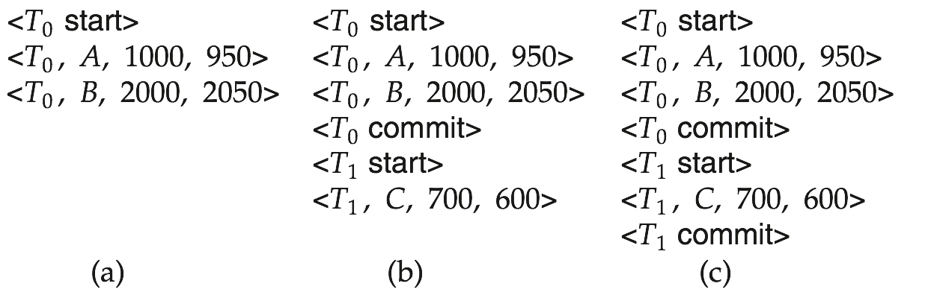
Figure 16.04

Slide 76

Figure 16.05

Slide 77
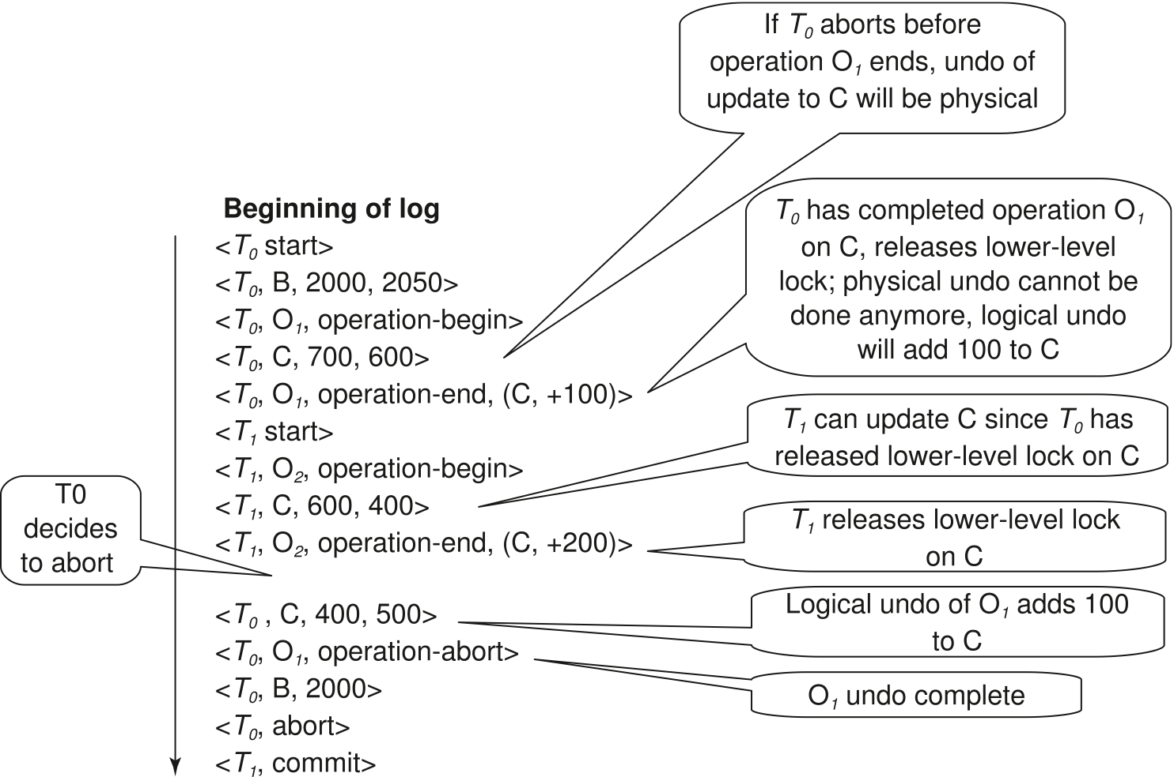
Figure 16.06

Slide 78
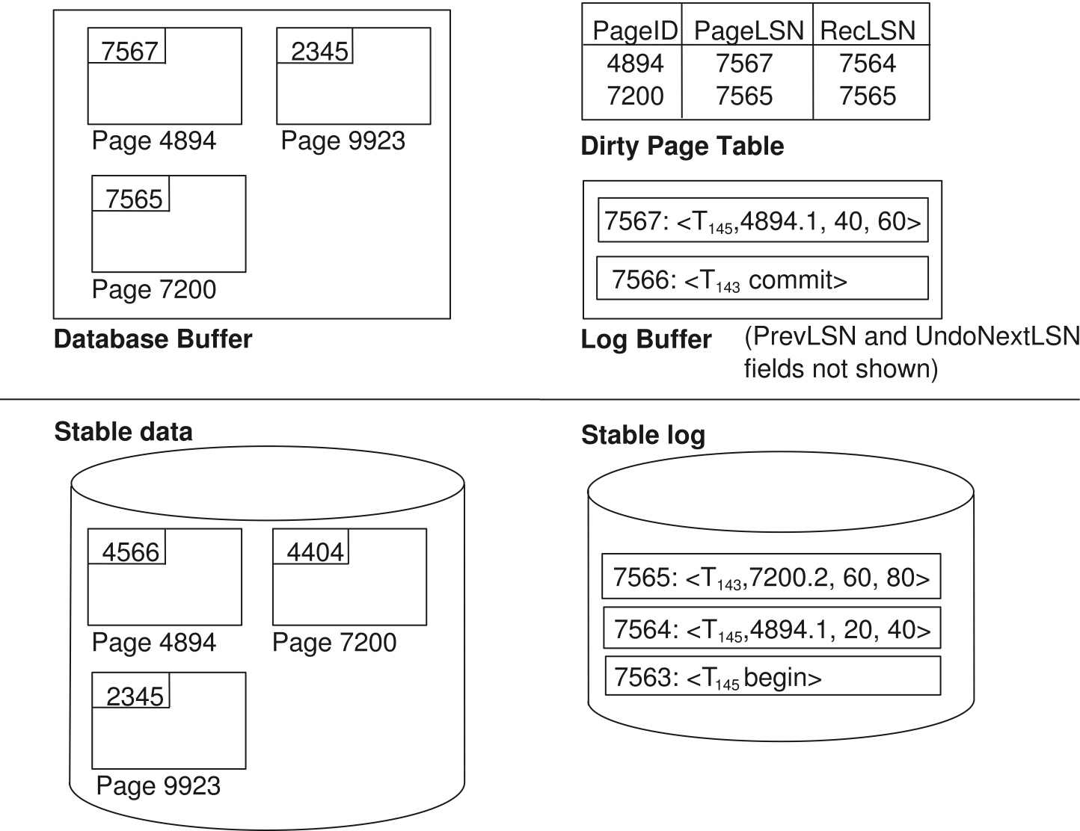
Figure 16.07

Slide 79
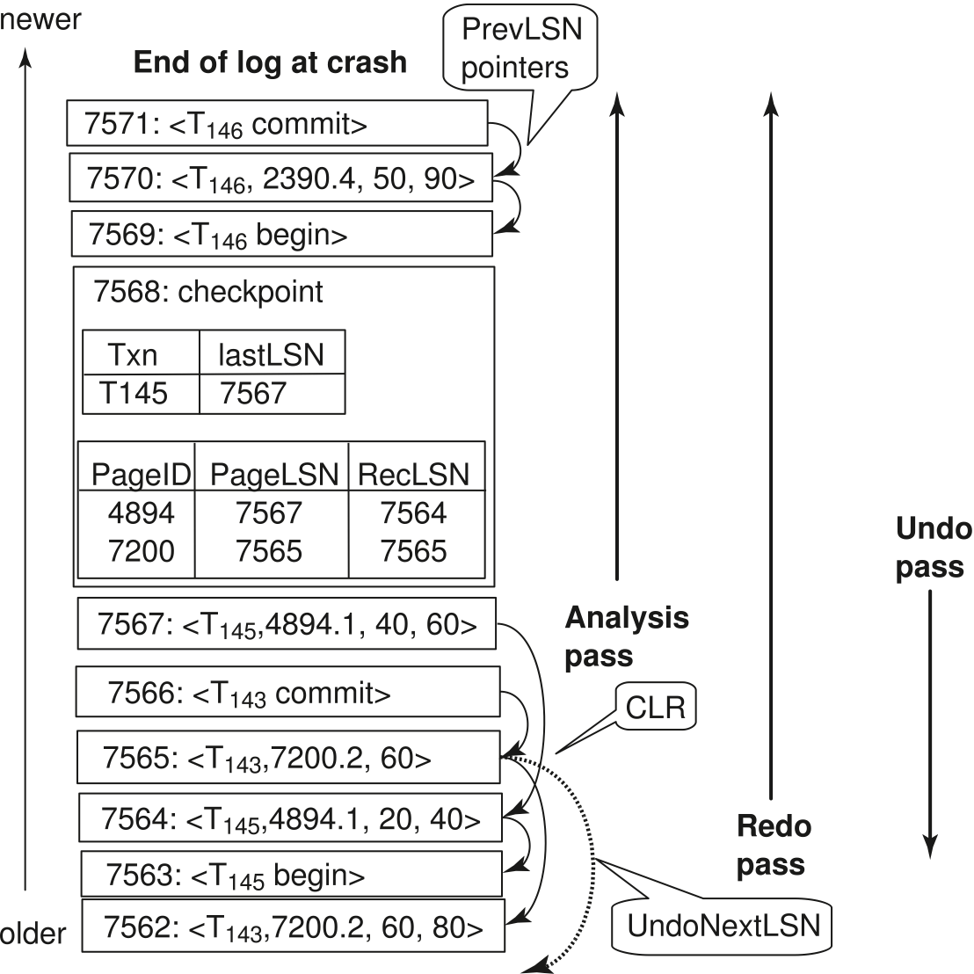
Figure 16.09

Slide 80
Figure 16.10

Slide 81
Extra

Slide 82
Shadow Paging
Shadow paging is an alternative to log-based recovery; this scheme is useful if transactions execute serially
Idea: maintain two page tables during the lifetime of a transaction –the current page table, and the shadow page table
Store the shadow page table in nonvolatile storage, such that state of the database prior to transaction execution may be recovered.
  Shadow page table is never modified during execution
To start with, both the page tables are identical. Only current page table is used for data item accesses during execution of the transaction.
Whenever any page is about to be written for the first time
  A copy of this page is made onto an unused page.
  The current page table is then made to point to the copy
  The update is performed on the copy

Slide 83

Sample Page Table

Slide 84

Example of Shadow Paging
Shadow and current page tables after write to page 4

Slide 85
Shadow Paging (Cont.)
To commit a transaction :
1. Flush all modified pages in main memory to disk
2. Output current page table to disk
3. Make the current page table the new shadow page table, as follows:
  keep a pointer to the shadow page table at a fixed (known) location on disk.
  to make the current page table the new shadow page table, simply update the pointer to point to current page table on disk
Once pointer to shadow page table has been written, transaction is committed.
No recovery is needed after a crash — new transactions can start right away, using the shadow page table.
Pages not pointed to from current/shadow page table should be freed (garbage collected).

Slide 86
Show Paging (Cont.)
Advantages of shadow-paging over log-based schemes
  no overhead of writing log records
  recovery is trivial
Disadvantages :
  Copying the entire page table is very expensive
    Can be reduced by using a page table structured like a B⁺-tree
      No need to copy entire tree, only need to copy paths in the tree that lead to updated leaf nodes
  Commit overhead is high even with above extension
    Need to flush every updated page, and page table
  Data gets fragmented (related pages get separated on disk)
  After every transaction completion, the database pages containing old versions of modified data need to be garbage collected
  Hard to extend algorithm to allow transactions to run concurrently
    Easier to extend log based schemes

Slide 87
Block Storage Operations

Slide 88

Portion of the Database Log Corresponding to T₀ and T₁

Slide 89

State of the Log and Database Corresponding to T₀ and T₁

Slide 90

Portion of the System Log Corresponding to T₀ and T₁

Slide 91

State of System Log and Database Corresponding to T₀ and T₁

